Slide 1

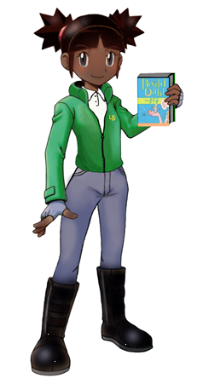
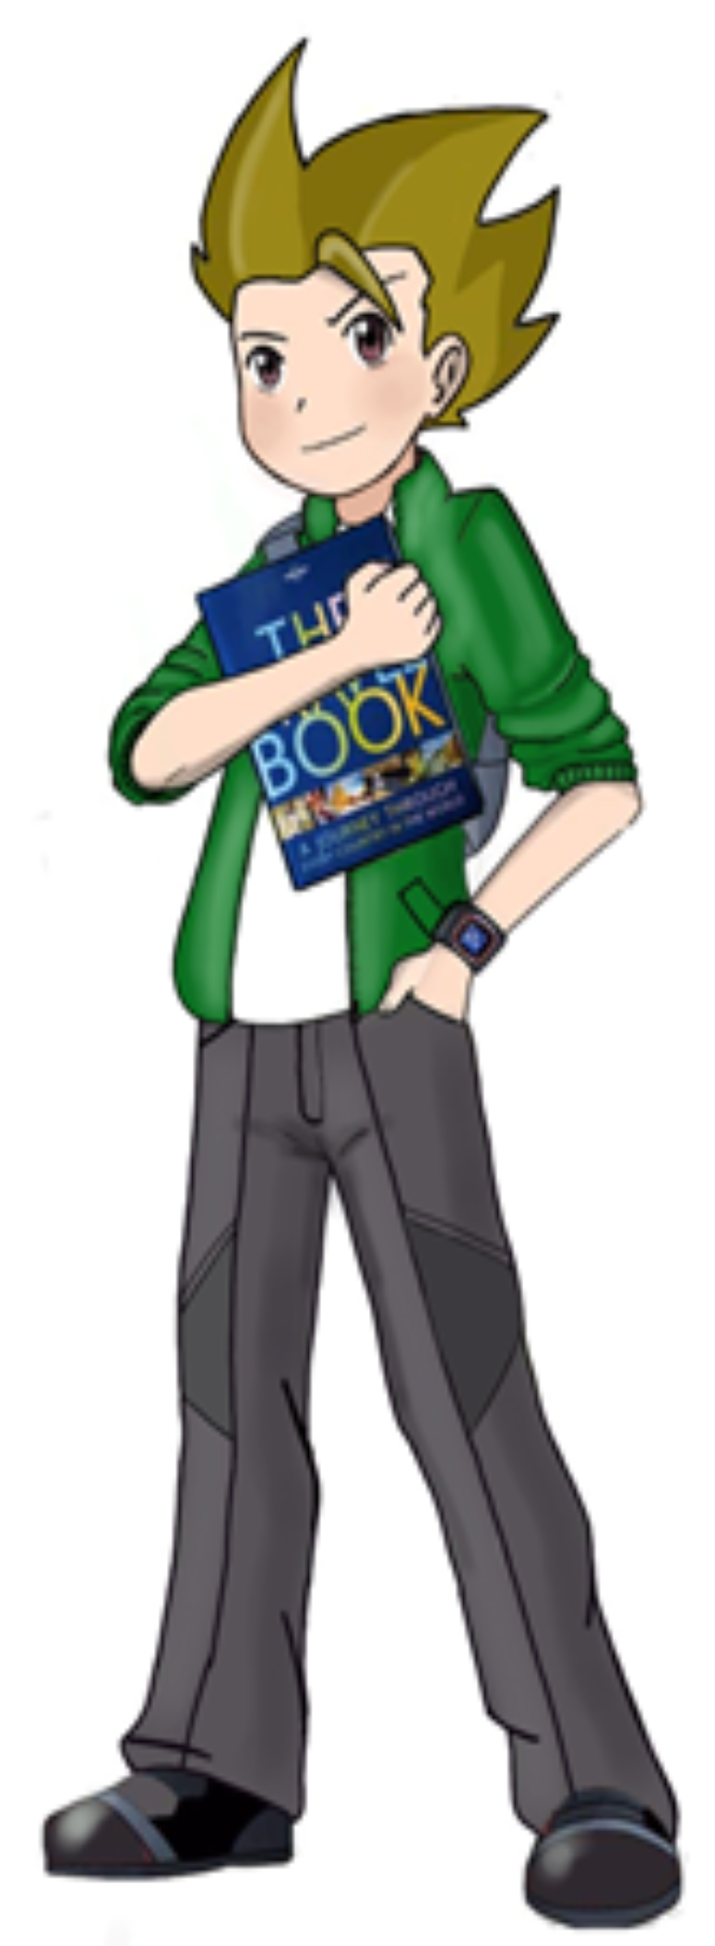

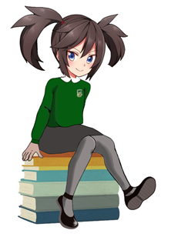
Reading at Loughton School
Leonie Hearne- Reading Lead
Boppy Wilmshurst – Deputy Reading Lead
Dee Newman- Phonics Lead

Slide 2

Aims
Reading vision
How we teach reading
Assessment
Phonics at Loughton School
Supporting your child at home

Slide 3
Reading mission statement at Loughton School
At Loughton School, we believe that reading is a gateway to new worlds that can expand our minds, our imagination and provide us with the building blocks to future success. We recognise the important role reading plays in children’s social and emotional development as well as the impact it can have on future attainment. According to research, spending just ten minutes a day reading increases children's general knowledge, vocabulary, fluency, and comprehension while also exposing them to almost 700,000 words annually.
https://www.loughton.milton-keynes.sch.uk/page/?title=Reading&pid=51

Slide 4
What does reading look like at Loughton School?
Children have at least 4 guided reading sessions a week
Children have access to books in their classrooms
Children have access to books from the library

Slide 5

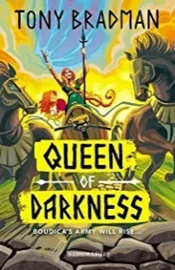


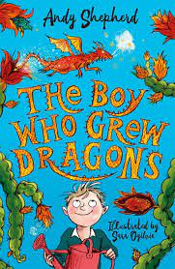



Guided Reading at Loughton
Year 3
Year 4
Year 5
Year 6

Slide 6

What does a guided reading lesson look like at Loughton?
A quick recap of last lesson’s reading – ‘quick start’
Vocabulary check
Class teacher reading the text and children follow along
Children having the opportunity to read aloud
Activities linked to our reading skills (characters)

Slide 7
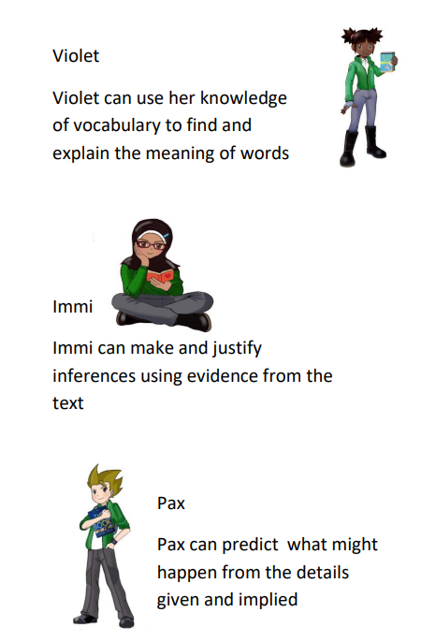
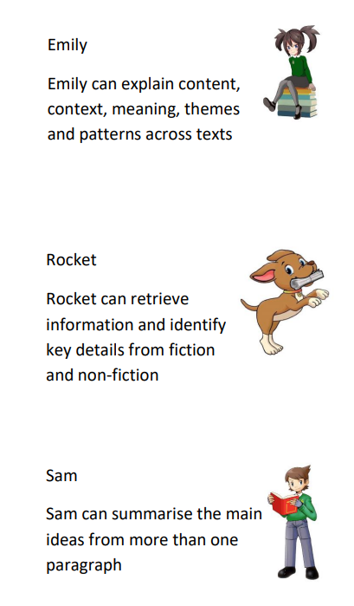
Our reading characters

Slide 8
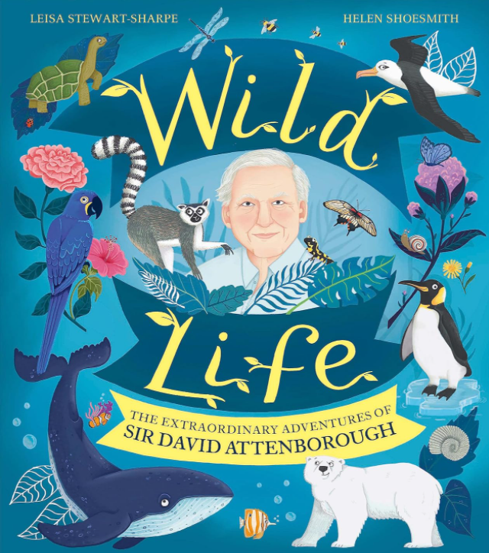
Quick start!
Example of a year 5 guided reading lesson
If this is the answer, what is the question?
Zoo Quest
Cambridge University
Australia’s Great Barrier Reef
Notes:
Lessons 4&5
What was the name of David’s first TV programme?
Where did he study?
Where did he go scuba diving?
Read the rest of the text, stopping to ask the questions on the next slides.

Slide 9

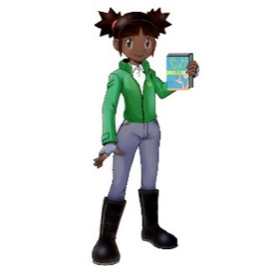
Individual thinking
‘From fish that clambered onto land 350 million years ago.’
What does clambered mean?
Why might it be difficult to imagine fish clambering?
Notes:
To climb or move in an awkward way.
They don’t have any limbs

Slide 10

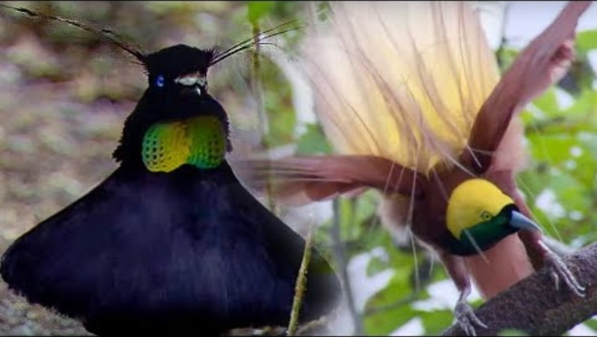
Individual thinking
‘It puffed out its feathers like an umbrella and frantically danced about, bobbing and bouncing, as its beady blue eyes bulged.’
Notes:
Ask the children what language features the author has used here (simile, alliteration). Watch video of the bird of paradise.

Slide 11

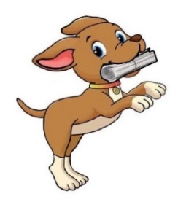
Partner Talk
Name three ways David encouraged others to protect the Earth.
Notes:
Made TV programmes, spoke to key leaders, spoke to crowds at Glastonbury.

Slide 12





Solo work – emotions graph
David Attenborough’s life
Emotions
A
B
C
D
E
F
Events
Notes:
Children to create a line graph tracking the emotions of Attenborough across significant events of his life. Some children will need graph drawn for them and events provided (template) while others can draw and label their own graph and choose their own events. T will need to model this activity carefully.

Slide 13
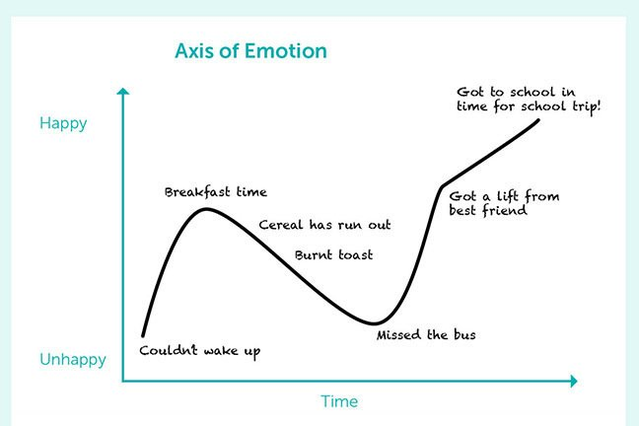
Plot a line graph of David’s emotions across events in his life.
You might want to include these events:
Getting a fire salamander for his birthday
Studying at Cambridge University
Presenting ‘Zoo Quest’
Scuba diving in the Great Barrier Reef
Meeting Lonesome George
Noticing the changes in our planet

Slide 14
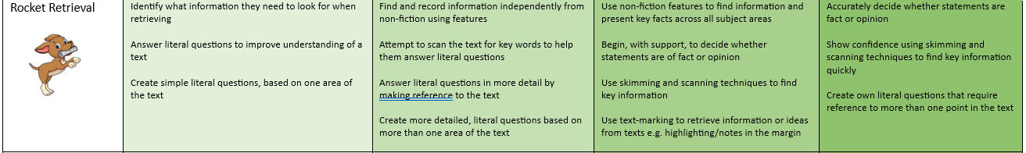
How do we assess reading?
Progression of skills
Years 3 – 5: termly reading assessments
Gap analysis informs planning
Teachers regularly listen to readers

Slide 15


Phonics at Loughton School
Dee Newman Phonics Lead

Slide 16
VISION STATEMENT​
At Loughton School, we are determined that every child will learn to read and become confident, fluent readers, and be competent at phonically decoding words. We use phonics as a tool to target the children who are at the early stages of learning to read, identified as below expectation. It is to support the Special Educational Needs children as well as the early readers who need extra phonics support to enable them to be positive, fluent readers, who engage with different types of texts.

Slide 17
At Loughton School, we believe that phonics or spelling (depending on the point of the child's learning journey), writing and reading share a cyclical relationship. They support each other and so without a firm understanding of phonics/spelling, children may not reach their full reading and writing potential. ​
​
We aim to give children the tools and strategies they will need to develop into confident spellers. We aim to instill a love of words by encouraging children to explore words, their origins and meanings. This will in turn feed into their writing and reading. We aim for any teaching of spelling to be robust, challenging and engaging.

Slide 18
At Loughton School, we continue to teach phonics primarily to the children who have not passed their phonics screening test in Year 1 and Year 2. We also ensure that the Special Educational Needs children are assessed and supported.

Slide 19
Phonics
Identifying sounds in spoken words.​
Recognising the common spellings of each phoneme. Which is the sound the letter makes.​
Blending phonemes into words for reading.​
Segmenting words into phonemes for spelling.​
Although there are 26 letters in the English alphabet, there are 44 speech sounds. ​

Slide 20
At Loughton School, we use Little Wandle letters and sounds programme
https://www.littlewandlelettersandsounds.org.uk/resources/for-parents/

Slide 21
Supporting your child at home
Hear your child read as often as possible and read to them. Please sign their home school reading journal whenever you hear them read.
Actively introduce new vocabulary to your child in day to day discussion and check they know the meaning of words.
Encourage your child to write shopping lists, birthday cards, invitations, thank you letters, postcards etc.
Talk about and ask questions about what your child is writing in school.
Encourage them to keep a diary or notebook where they can jot down ideas.

Slide 22
Thank you for coming.
Do you have any questions?

