Slide 1
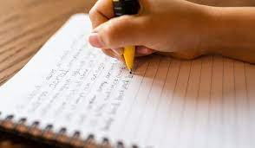
Writing at Loughton School
‘Our vision at Loughton School is for our children to explore a wide variety of genres of both fiction and non-fiction writing whilst learning via our immersive curriculum.
We believe that all children should develop their own style and have the courage to use their imagination and creativity to publish well-presented pieces that they can take pride in.’

Slide 2
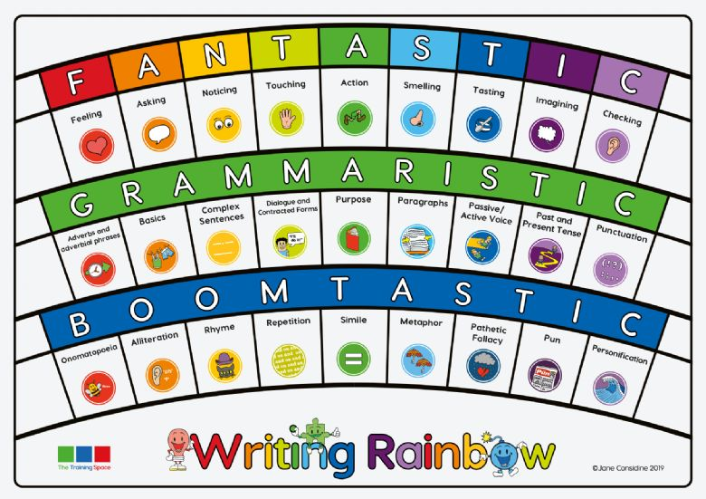
The Writing Rainbow
Provides a structure to teach all elements of English creative writing
Children use the 36 icons regularly on their writing journey throughout the school
Provides additional support when writing independently
Teachers can ensure they are teaching a variety of writing skills

Slide 3

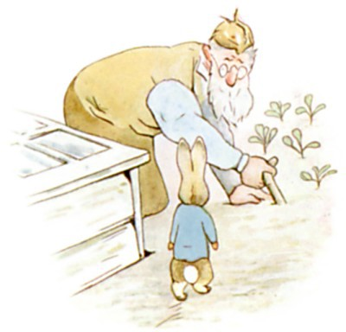
Adverbial phrase
Who has spotted Peter coming towards him?
Where are the characters?
Model
Peter came around the corner and spotted Mr McGregor planting
new seedlings in his vegetable patch.
Notes:
Learning Chunk 1 – Explain that you want to use an adverb or adverbial phrase in the sentence to help the reader to follow what is happening. Today’s adverbial phrase will tell us where the characters are.
Where is Mr McGregor? Behind the cold frame (wooden frame where seedlings are kept), kneeling down, digging his vegetable patch, concentrating on his work, planting his seedlings, planting seeds, weeding the patch, weeding the garden, on his hands and knees, planting young cabbages.

Slide 4

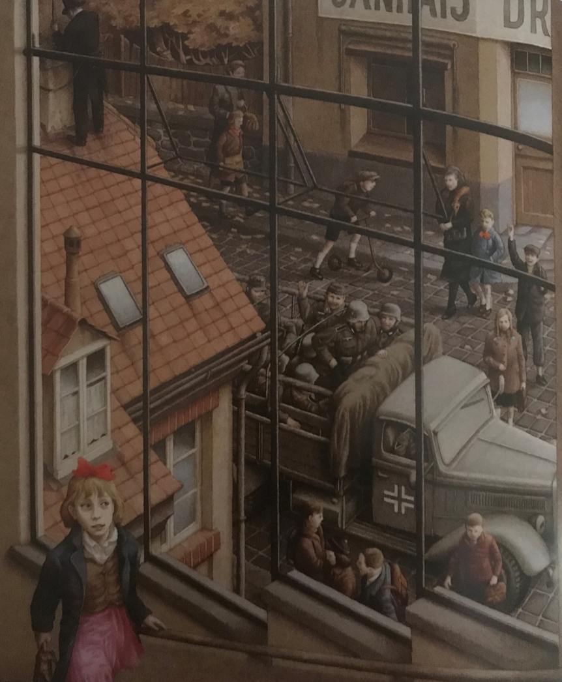
You are going to find three clues in the picture which symbolise war.
Now think of metaphors which symbolise war is coming.
Model
The grey cloak that hung over the village shadowed a monstrous tank which lurked in the cobbled streets, reminding Rose that life was not the same.
Notes:
Learning Chunk 2. Negative clues which symbolise war: soldiers, tank, atmosphere, children being escorted by parents. Negative metaphors to signify war eg: ominous crow, dark smog, harsh frost, dusty rail. Model sentence, ask them to explain what the dark cloak is a metaphor for (atmosphere / mood)

Slide 5
Teaching and learning
Planning looks the same throughout the school
Each unit of work follows the same structure
Vocabulary is shared orally which extends the more able and supports the less able
Writing stamina is improving as children are writing every day
Teachers see the children’s writing in lessons and can give instant feedback while over-shoulder marking

Slide 6
Writing Assessment
We assess children via their independent writing across a range of fiction and non-fiction genres which relate closely to the topics they are learning about and also the high-quality texts they are reading in their guided reading lessons.
Teachers assess using the national curriculum writing objectives (Teacher Assessment Framework for the end of key stage 2 2018/19 onwards) which enables us to decide whether your child is working below or towards the standard for their year group, at the expected standard for their year group or working at a greater depth.
The sentence stacking lessons support the children in learning how to write effectively for a specific purpose, using the correct features. The sentence stack is displayed in the classroom to support all children when they are writing independently. Once the children reach year six, the sentence stack and modelling is removed in order for the children to produce their best writing completely independently to allow for accurate assessment and moderation.

Slide 7
What we did last year to improve our provision:
Teachers demonstrate their own writing during each lesson to show all children how to write cohesively and creatively using a wide range of vocabulary and grammatical structures in order to achieve their potential.
We have seen children becoming more independent in their editing. They use a range of different resources to support them.
OFSTED looked at the way we teach writing and were impressed with the range of genres and the links to the curriculum. They were impressed by the support our children receive.
All children are provided with a target after each piece of independent writing so that they know what they need to do to improve.

Slide 8
What we did last year to improve spelling at Loughton School:
We know our children have struggled more with spelling over the past years so we visited a local school to see how they were dealing with the same issue.
We bought a whole school subscription to Spelling Shed. Our teachers now teach high quality spelling lessons 4 x weekly.
Children have a weekly homework which they com They were impressed by the support our children receive.
All children are provided with a target after each piece of independent writing so that they know what they need to do to improve.
We visited a local school to see how they have addressed the issue of poor spelling.
Our teachers now have access to high quality lesson planning
Children access their homework via Spelling Shed's website and are celebrated for their commitment rather than achievement.
Spelling is a priority for the school and the children can see the importance.

Slide 9
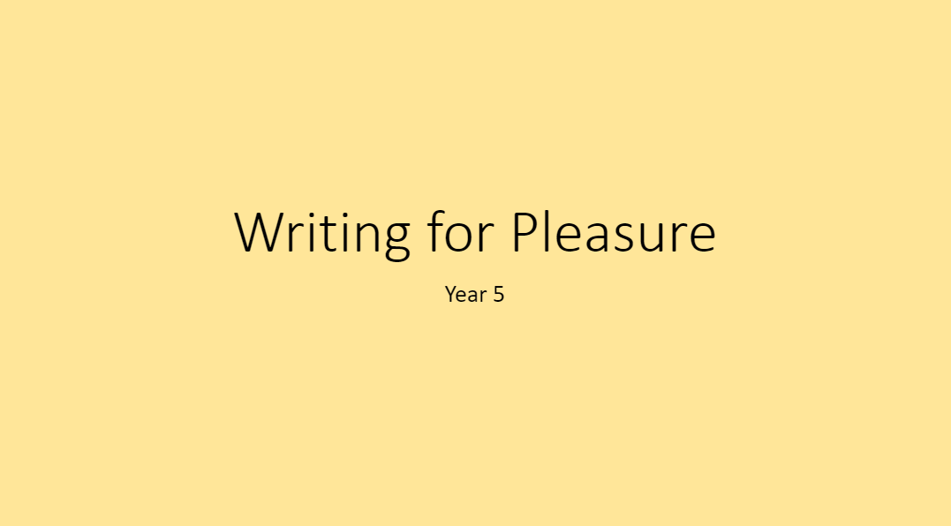
Writing for Pleasure
This year, we have introduced a weekly, 15-minute writing for pleasure slot for each year group.
This is to help to bring creativity and a love of writing to our students, whilst helping to improve their writing stamina.
These sessions are more informal than our writing lessons and, whilst we always encourage accurate use of grammar, punctuation and spelling, without the pressure of the writing being marked and assessed the children can be freer to write in a more creative and pleasurable way.

Slide 10
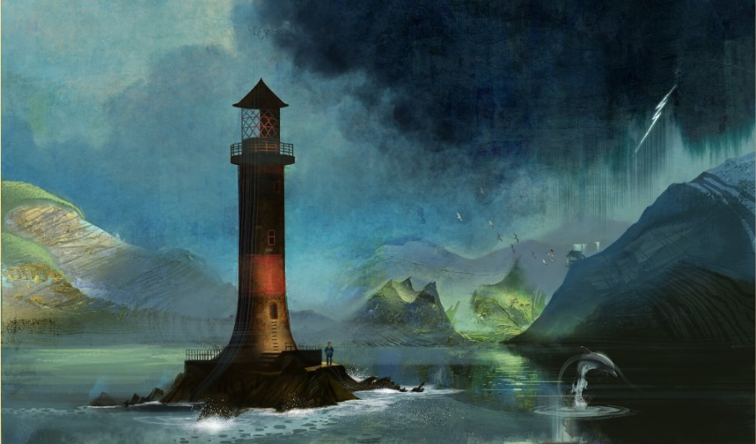
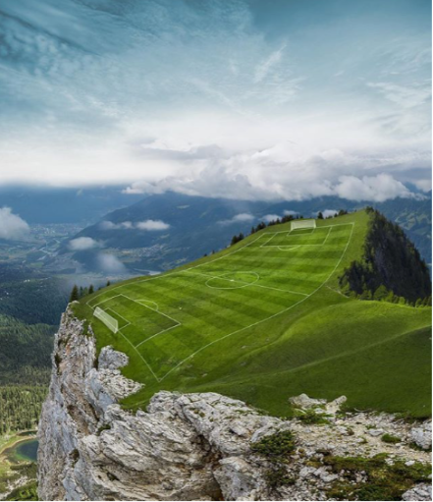



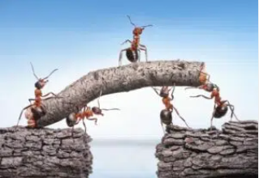
Each session is centered around a stimulus, this can be anything from a picture from a book linked to a topic the children are studying, a music album cover, a Pokémon, a short video clip, whatever we think might inspire the children to write creatively.
They are shown the stimulus and then must choose what type of writing they will complete based upon it: a story, a poem, playscript, song, information text, instructional writing, letter etc.
They then use the 15 minutes provided to write.
Sometimes the children are invited to share their work with the class or just the teacher will look at it at the end of the session, but no formal marking will take place.

Slide 11
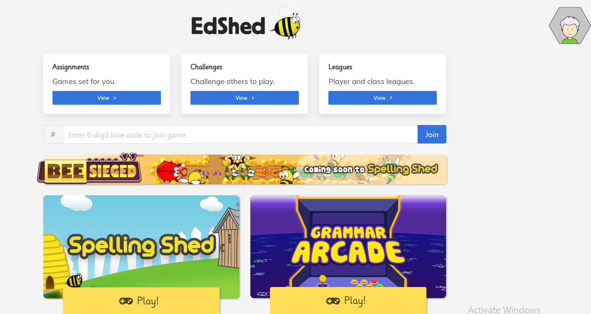
SPELLING SHED

Slide 12
Linkpen
We have purchased a font which all teachers are now beginning to use in the planning they produce for the children.
This means that the children are seeing the same font and letter formation and it is encouraging them to improve handwriting and remember to join their handwriting.
OFSTED asked us to make sure that the children always take pride in the presentation of their work. We listened and have already made changes to our expectations in the classroom.

