Slide 1
Year 6 SATs 2026
presentation for parents, carers & guardians

Slide 2
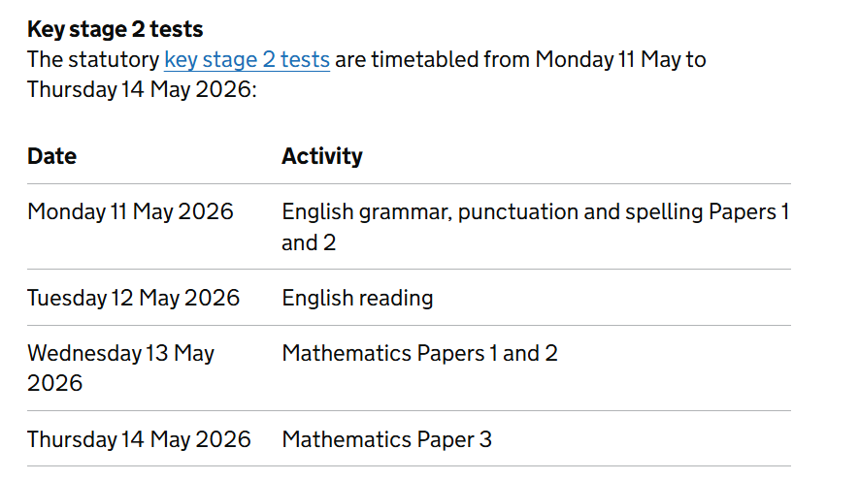
What are the SATs?
SATs [Standard Assessment Tests] is a term people use to refer to End of Key Stage 2 Assessments;
Writing is assessed using evidence collected by your child’s teacher throughout Year 6, so there is no Year 6 SATs writing test. We will look at a collection of writing which your child has completed independently in school and make a judgement based on the objectives given to us by the government.
This writing may be moderated by the Local authority.
The key stage 2 tests will be taken on set dates unless your child is absent, in which case they may be able to take them up to 5 school days afterwards.
Science sampling has not taken place over the past couple of years. We have not been notified if this will happen this year.
Notes:
Jane

Slide 3
When and how are the SATs carried out?
On the morning of each test, we will host a breakfast club for all year 6 pupils. This will give them a chance to relax, talk to their friends and be mentally prepared to sit their tests.
The tests will take place during normal school hours, under exam conditions.
Children are not allowed to talk to each other from the moment the assessments are handed out until they are collected after the test has ended. Pupils will have a break after each test.
Afterwards, the completed papers are sent away to be marked externally.
The children’s results are sent back to school at some point in July.
The standard timings of tests differ but last no more than 60 minutes.
Notes:
Jane

Slide 4
Specific arrangements for SATs
Children with additional needs, who have similar provision in their day-to-day learning at school, may be allotted specific arrangements:
additional (extra) time,
tests being opened early to be modified,
an adult to read for them,
an adult to scribe (write) for them,
written or spoken translations of the mathematics reasoning papers,
use of prompts or rest breaks
arrangements for children who are ill or injured at the time of the tests.
You will be notified if this applies to your child.
*Pupils with an EHC plan are automatically allowed up to 25% additional time (except for the spelling paper, which is not strictly timed). Pupils who use the modified large print or braille versions of the tests are automatically allowed up to 100% additional time
Notes:
Charlie

Slide 5
What sort of results are reported?
Once marked, the tests will be given the following scores:
A raw score (the total number of marks achieved for each paper)
A scaled score (which is explained below)
A judgement of whether the National Standard has been met.
After marking each test, the external markers will convert each raw score into a scaled score to show whether each child is working below, at or above the national standard.
When the scaled score is given, it is given in a range from 80 to 120.
A scaled score of 100 or more is meeting the national standard.
There are no separate tests for higher achieving pupils, however a scaled score over 110 (based on historical reporting) would show that a child is working above the national standard or Greater Depth.
Notes:
Charlie

Slide 6
Grammar, Punctuation and Spelling
Grammar, Punctuation and Spelling is made up of two papers which will take place on Monday 11th May 2026:
Paper 1 is the longer paper lasting 45 minutes. This tests the children using a range of grammar, punctuation and spelling tasks.
Paper 2 is a shorter paper lasting 20 minutes, where children will be tested on spelling only. They are asked to fill in a blank within a sentence, attempting to spell out the spelling word in context correctly.
Notes:
Jane

Slide 7
Grammar, Punctuation and Spelling (Paper 1)
Grammar, Punctuation and Spelling (Paper 1) is the longer paper lasting 45 minutes, which takes place on Monday 11th May 2026.
The children will be prepared by their class teacher so they are equipped with a good knowledge of the technical vocabulary needed to identify and describe various aspects of grammar and punctuation marks.
Grammar, Punctuation and Spelling (Paper 1) focuses on the following areas:
- Grammatical terms/word classes;
- Functions of sentences;
- Combining words, phrases and clauses;
- Verb forms, tenses and consistency;
- Punctuation;
- Vocabulary;
- Standard English and formality.
Grammar, Punctuation and Spelling (Paper 1) requires a range of answer types such as circling missing capital letters, multiple choice questions and one-word answers. There may occasionally be a question which requires the children to explain the difference in meaning between two sentences.
Notes:
Jane

Slide 8
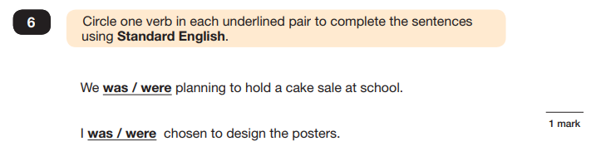
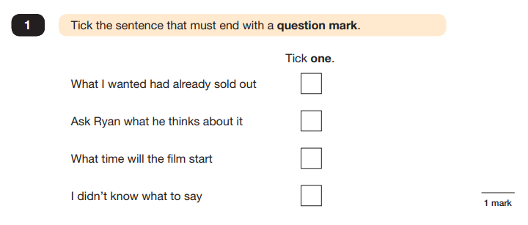
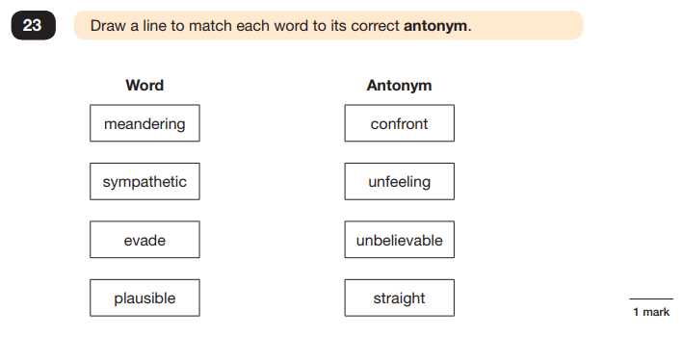
Grammar, Punctuation and Spelling (Paper 1)
Example questions:
Notes:
Jane

Slide 9
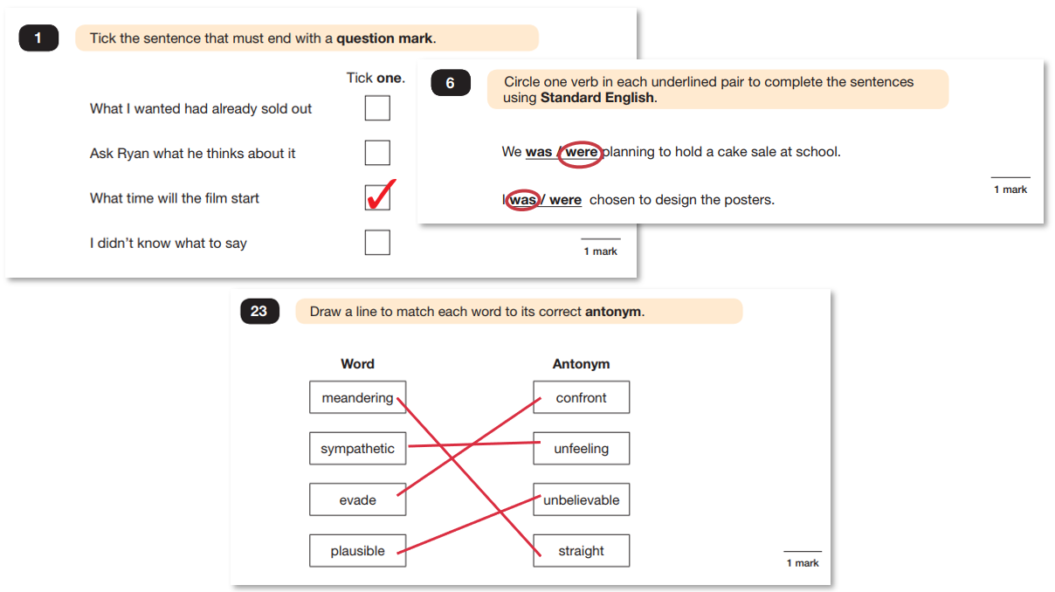

Slide 10
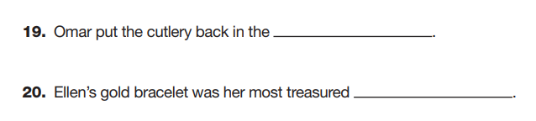
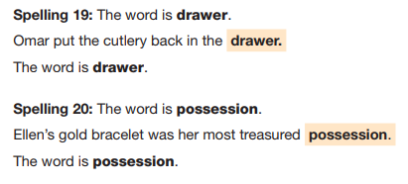
Grammar, Punctuation and Spelling (Paper 2)
Grammar, Punctuation and Spelling (Paper 2) is the shorter paper lasting 20 minutes, which takes place on Monday 11th May 2026.
Example questions:

Slide 11
Reading
The Year 6 Reading SATs paper will be sat on Tuesday 12th May 2026.
The assessment has been designed to measure whether children’s comprehension of age-appropriate reading material meets the national standard.
The test lasts 60 minutes, including reading the texts and answering questions. There are three different set texts for the children to read, which could be any combination of non-fiction, fiction and/or poetry.
The Reading paper focuses on the following areas known as Content Domains:
2a) give/explain the meaning of words in context;
2b) retrieve and record information/identify key details from fiction and non-fiction;
2c) summarise main ideas from more than one paragraph;
2d) make inferences from the text/explain and justify inferences with evidence from the text;
2e) predict what might happen from details stated and implied;
2f) identify/explain how information/content is related and contributes to meaning as a whole;
2g) identify/explain how meaning is enhanced through choice of words and phrases;
2h) make comparisons within the text.
The Year 6 Reading SATs paper requires a range of answering styles, including responding to multiple choice questions, one-word answers, and multiple-mark questions which require more formal paragraph-length answers.
Notes:
Leonie

Slide 12
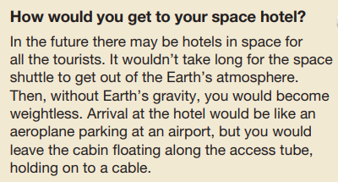
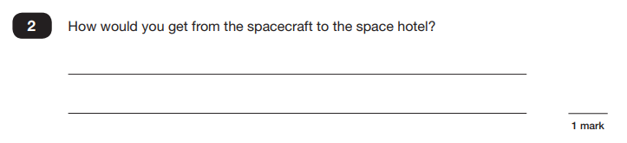
Reading
Example question, based on Text 1 – Space Tourism:
2b) retrieve and record information/identify key details from fiction and non-fiction

Slide 13
Reading
Example question, based on Text 1 – Space Tourism:
2b) retrieve and record information/identify key details from fiction and non-fiction

Slide 14
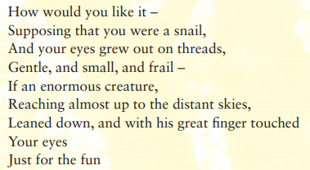
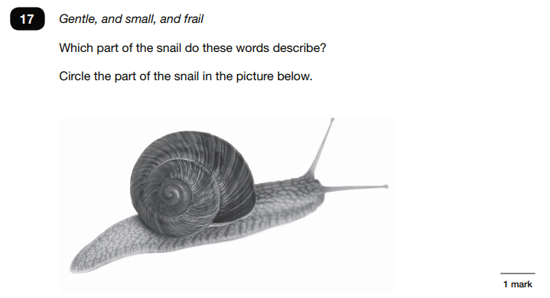
Reading
Example question, based on
Text 2 – Giants:
2b) retrieve and record information/identify key details from fiction and non-fiction

Slide 15
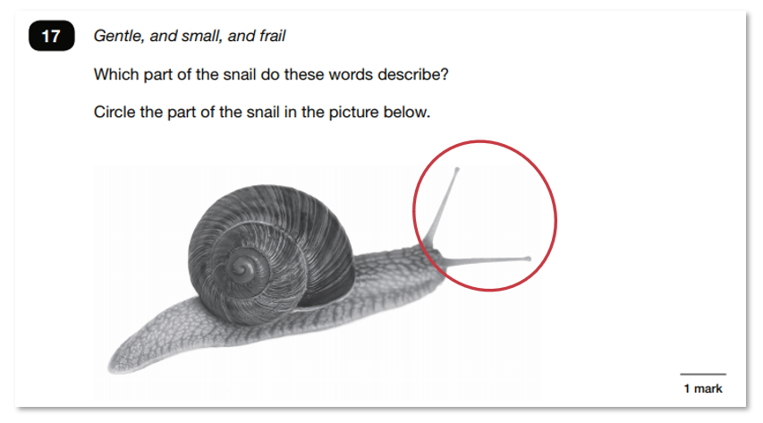
Reading
Example question, based on
Text 2 – Giants:
2b) retrieve and record information/identify key details from fiction and non-fiction

Slide 16
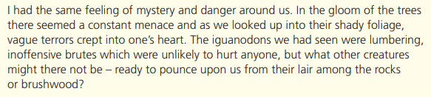
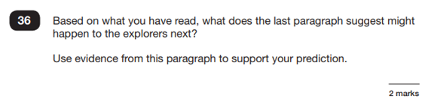
Reading
Example question, based on Text 3 – The Lost World:
2e) predict what might happen from details stated and implied

Slide 17
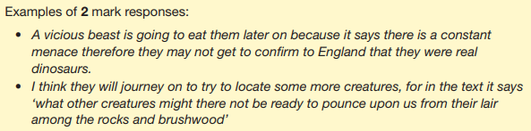
Reading
Example question, based on Text 3 – The Lost World:
2e) predict what might happen from details stated and implied

Slide 18
Reading
Since the current testing format for the Year 6 SATs began in 2016, reading papers have consistently focused heavily on a small group of content domains, particularly vocabulary in context (2a), retrieval (2b) and inference (2d). This trend has continued in the most recent SATs papers.
In the 2025 KS2 Reading SATs:
Inference questions (Content Domain 2d) accounted for the largest share of marks, with around 48% of marks focusing on making inferences from a text or explaining and justifying them with evidence. This was the highest proportion of inference marks seen in recent years and continues the trend of inference being the dominant focus. (primary.lbq.org)
Retrieval questions (Content Domain 2b) still formed a significant portion of the paper, contributing approximately 30% of marks. (primary.lbq.org)
Vocabulary in context (Content Domain 2a) questions made up around 12% of the marks, showing they remain an important part of the paper. (primary.lbq.org)
Taken together, 2a (vocabulary), 2b (retrieval) and 2d (inference) consistently make up around 90% or more of the marks on the reading paper, emphasising the need for pupils to be secure in these skills. (hfleducation.org)
So, when reading with your child at home, try asking questions like:
Find a word in this paragraph that is closest in meaning to ‘__’ e.g. annoyed (Content Domain 2a) (GOV.UK)
In what year did ‘__’ happen? e.g. when did the French authorities make it illegal for people to swim from France to England? (Content Domain 2b) (GOV.UK)
In the last paragraph, X does not want to Y. Give two reasons why X does not want to Y. (Content Domain 2d) (GOV.UK)
Notes:
Example text (last paragraph):
As the boat edged closer to the shore, Tom tightened his grip on the rope. The wind had picked up and the waves slapped hard against the side. He thought about how far he still had to travel and glanced back at the darkening sky. With a sigh, he turned the boat around and headed back the way he had come.
Question (Content Domain 2d – inference):
In the last paragraph, Tom decides not to continue his journey.
Give two reasons why Tom does not want to continue.
Model answer:
The weather is getting worse because the wind has picked up and the waves are hitting the boat hard.
It is getting dark, shown by the darkening sky, which makes continuing the journey unsafe.

Slide 19
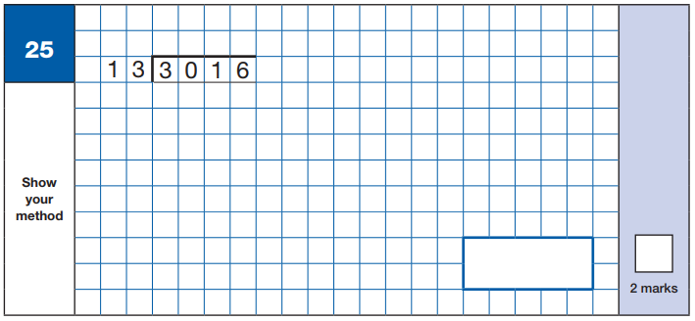
Maths Paper 1 (Arithmetic)
Maths Paper 1 (Arithmetic) will take place on Wednesday 13th May 2026.
It has a standard timing of 30 minutes and is worth a total of 40 marks.
It covers the four operations (division, multiplication, addition, subtraction and mixed operation calculations requiring BIDMAS), as well as number properties, calculating percentages of amounts, calculations using decimals, and calculations using fractions.
Example question:
Notes:
Charlie

Slide 20
Maths Paper 1 (Arithmetic)
1 – 13
2 – 26
3 – 39
4 – 52
5 – 65
6 – 78
7 – 91
8 – 104
9 - 117
10 - 130
2 3 2
2 6 0 0 13 x 200
4 1 6
- 3 9 0 13 x 30
2 6
- 2 6 13 x 2
0 + 232

Slide 21

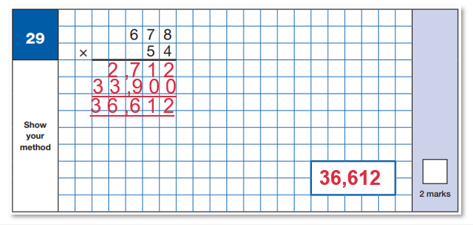
Maths Paper 1 (Arithmetic)

Slide 22
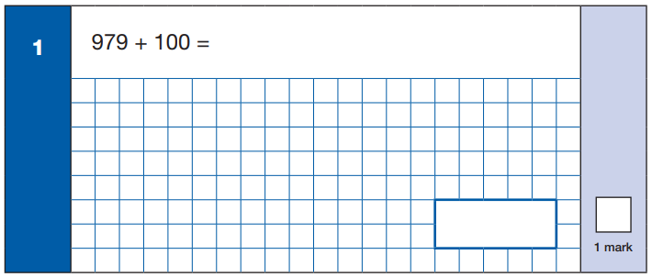
1,079

Slide 23
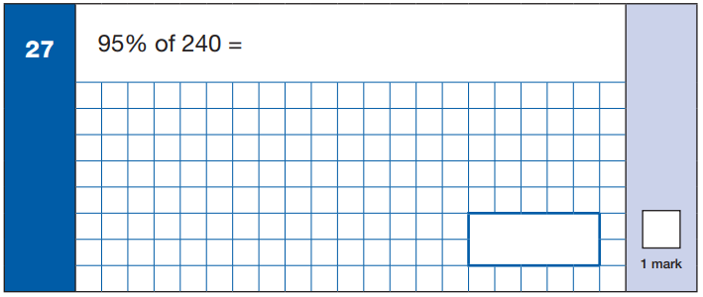
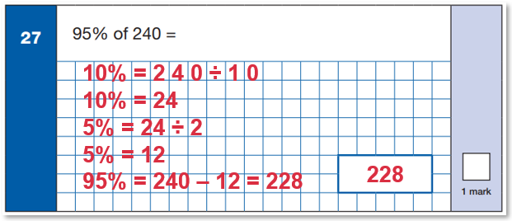

Slide 24
Maths Papers 2 & 3 (Reasoning)
Maths Paper 2 (Reasoning) will take place on Wednesday 13th May 2026
Maths Paper 3 (Reasoning) is scheduled for Thursday 14th May 2026
Both have standard timings of 40 minutes and are worth 35 marks each.
Paper 2 requires children to demonstrate their mathematical knowledge and skills, as well as their ability to solve problems and their mathematical reasoning.
Questions focus on the following mathematical topic areas:
- Number and place value– including Roman Numerals;
- Addition, subtraction, multiplication and division (calculations);
- Geometry – properties of shapes;
- Geometry – position and direction;
- Statistics;
- Measurement – including length, perimeter, mass (weight), volume, time and money;
- Algebra;
- Ratio and proportion;
- Fractions, decimals and percentages.
The questions get harder throughout the paper.
It is not unusual for a child to be unable to complete the entire paper in time.

Slide 25
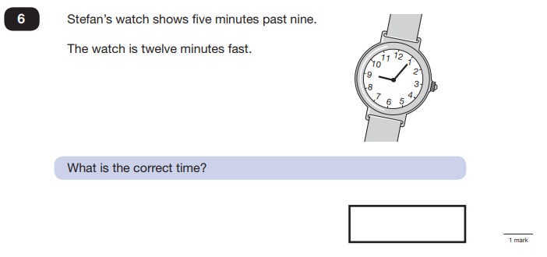
Maths Paper 2 (Reasoning)
Example questions:
7 minutes to 9 or
8:53

Slide 26
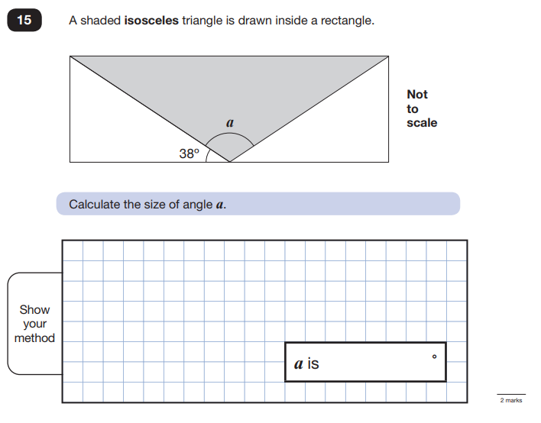
Maths Paper 2 (Reasoning)
Example questions:

Slide 27
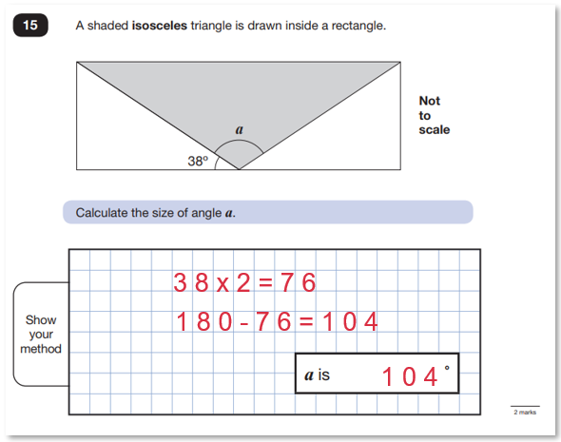

Slide 28
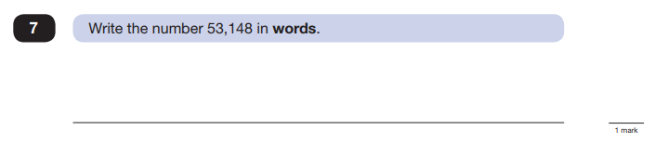
Maths Paper 3 (Reasoning)
Example questions:
Fifty-three thousand, one hundred and forty-eight

Slide 29
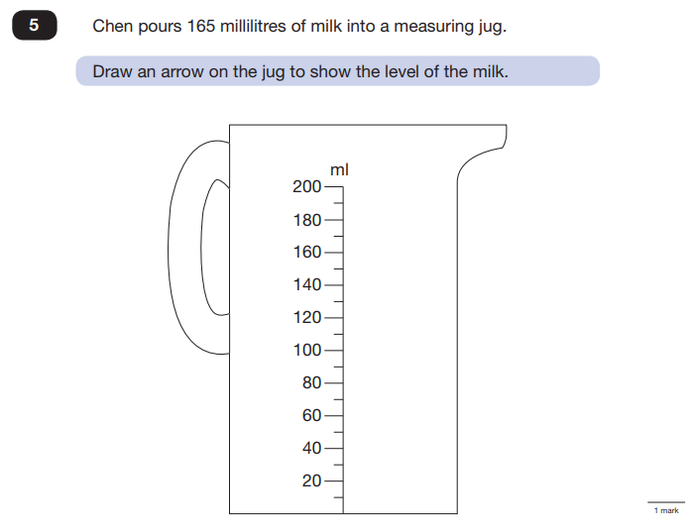
Maths Paper 3 (Reasoning

Slide 30
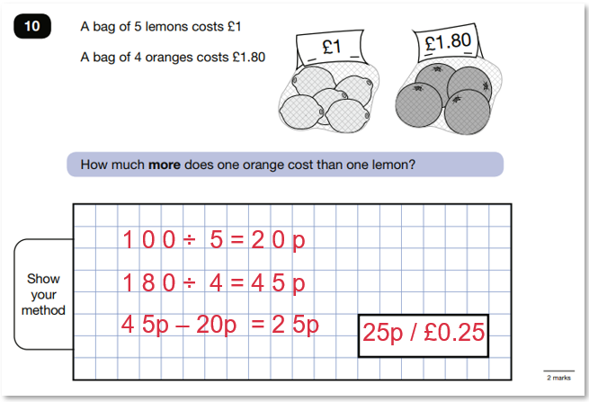
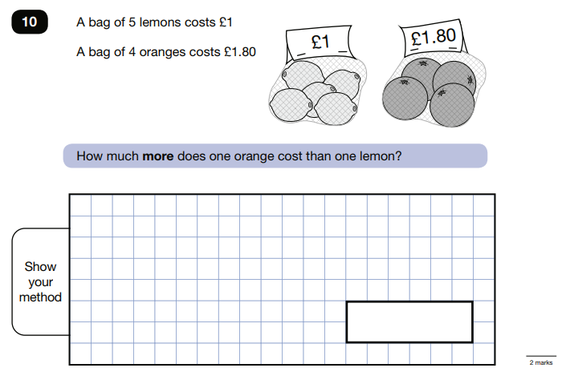
Maths Paper 3 (Reasoning
Example questions:

Slide 31
How can I support my child in preparing for their SATs?
Firstly, a positive attitude goes a long way – so please give them as much encouragement and support as possible (but we don’t need to tell you that)!
Some further tips:
Direct any questions or concerns you have about SATs to your child’s teacher, rather than worry your child with them;
Give your child opportunities to go outside and avoid overuse of screens - this can apply to leisure pursuits as well as how they study;
Try to provide a quiet corner of the house for homework and study, that’s as free from distractions as possible;
Encourage your child to talk to their teacher or another adult they trust if they express persisting anxieties about SATs. Remember that a small amount of anxiety is normal and not harmful;
If your child is unwilling to talk to their teacher, please contact us via email
DO NOT USE PAST PAPERS. If your child has a tutor, please
insist they do not use them!

Slide 32
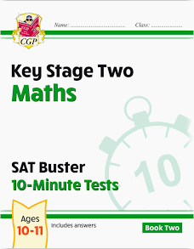

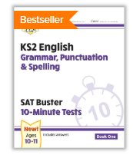
CGP Books – we recommend the SAT Buster 10-minute tests.
These three books are available from CGP at a cost of £15.
This week, we will be sending a letter offering a special discounted price if purchased through school:
Reading and SPAG books: £7.35
Maths book bundle: £8.00
Please look out for the ParentMail that was sent before the Autumn break.

Slide 33
CGP also have some free online tests which can be accessed via the link below.
Free online 10-minute tests for maths and SPaG

Slide 34
Remember this about SATs:
SATs focus on what they know about Maths and English
They won’t reflect how talented they are at Science, Geography, Art or PE, and they certainly won’t highlight positive personal characteristics such as kindness and integrity.
SATs results don’t always tell the whole story
The results will say they DID or DIDN’T meet a certain standard, but not necessarily by what margin. Additionally, the thresholds tend to change each year according to overall national performance, so what was classed as ‘did meet the expected standard’ in 2017 may have been considered a ‘did not’ in 2016. Your school may be able to provide you with more detailed feedback, so don’t let your child see SATs as a simple case of ‘pass’ or ‘fail’.
SATs last for one week (actually 4 days!)
In reality it’s just one or two papers lasting 30-60 minutes each day. You can’t emphasise enough the importance of keeping that in perspective.

Slide 35
A final message to you….
Your child’s wellbeing is what is most important and that should be at the forefront of all our minds as the SATs approach.
Leading up to the week of SATs, your child(ren) will be working hard to revise all that they have learnt during their time at Loughton School.
Ensure that they take this time to relax and remind them that they are AMAZING! Remind them of how far they have come and that whatever the outcome, we are all so proud of what they have achieved.
Have fun, allow them to play and ensure they have enough sleep. Tests are not the be all and end all; they only capture a moment in time.

