Slide 1

Staffordshire
Year 6 residential
Wednesday 27th – Friday 29th September 2023

Slide 2

– Key details
- An introduction to Kingswood
– Benefits of Outdoor Learning
– Sleeping and Eating
– What to Expect
– Safety and Wellbeing
- What To Bring

Slide 3

When is the trip?
Wednesday 27th September – Friday 29th September 2023 (2 nights)
Where is it?
Kingswood Centre in Staffordshire
How are we getting there?
By coach – takes approximately 2 hours
Coach leaves 8.30am on Wednesday 27th
Returns 3.15pm on Friday 29th
Attendees
Miss Hearne – Trip leader Mr Taylor
Mrs Newman + 1 support staff member
Notes:
Lunch is provided on Weds so no need for packed lunches

Slide 4
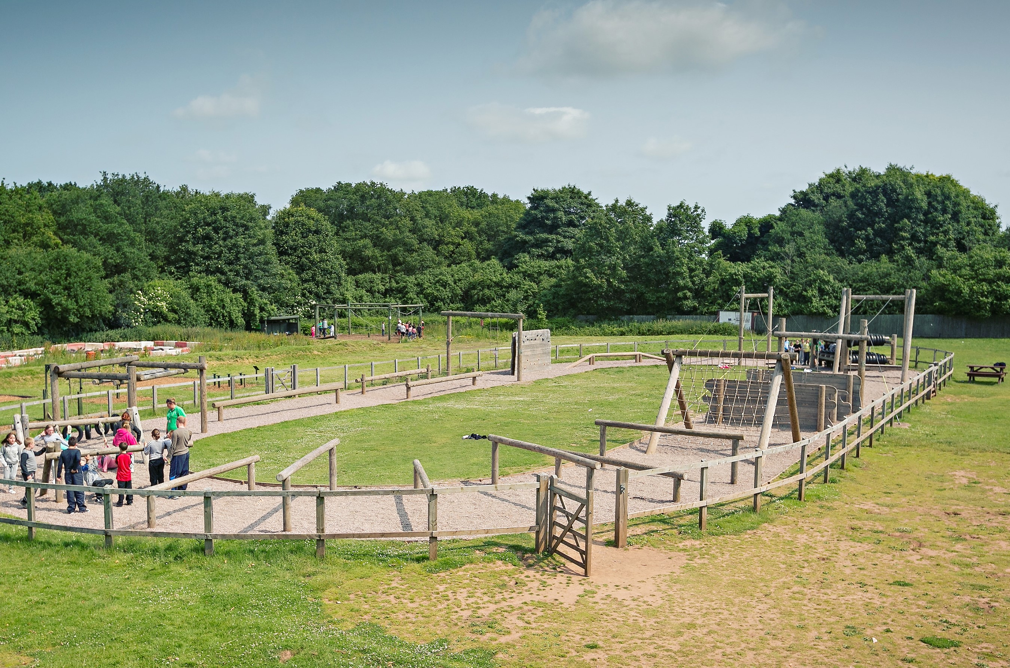
Staffordshire Centre - introduction
Approximately 2 hours away
Picturesque centre overlooking the countryside
Adventure apparatus including zipwire and abseiling, archery, bushcraft and low ropes course
Flexible indoor space for all-weather activities including problem solving and team challenges
Notes:
Centre is around 2 hours away – just on from Wolverhampton
A picturesque centre – secure, overlooks the countryside and has plenty of space
All the activities on the trip are land-based as there isn’t a water facility there
Adventure apparatus including zipwire and abseiling, archery, bushcraft and low ropes course
Flexible indoor space for all-weather activities including problem solving and team challenges

Slide 5
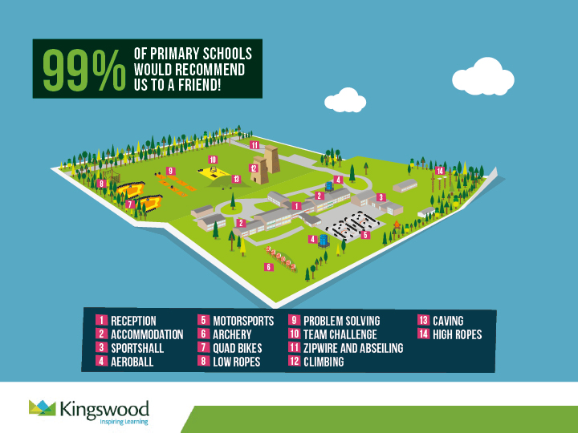
Notes:
Map of the site – everything is within easy reach (accommodation, sports hall, outdoor apparatus)
Children will be supervised by adults at all times

Slide 6

Benefits of outdoor learning
Promotes independence
Encourages respect for other students and teachers.
Helps them prepare for the next stage of their education
Positive start to the year – making great memories
Notes:
Choose to organise the residential at the start of year 6 to promote independence, help them build relationships with their peers and their teachers
Opportunity to develop team work skills and build their confidence, in preparation for the next stage of their education, looking after each other
Positive start to the year – making great memories
Might be the first time away from home for some of the children – 2 nights away is the perfect amount of time to develop that independence but have the reassurance of being home fairly soon

Slide 7
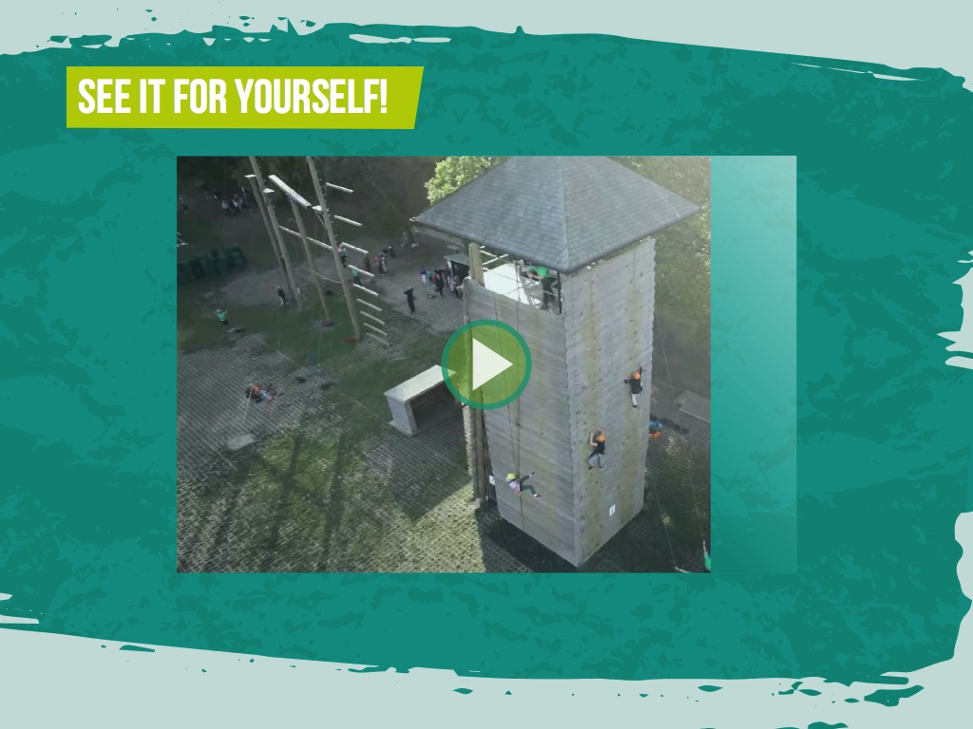

https://www.youtube.com/channel/UCy0___ghMVMWC_5THw2iogg
Notes:
https://www.youtube.com/watch?v=X7nRAj3ItzI
Gives an insight to the kinds of activities the Kingswood residential offers

Slide 8
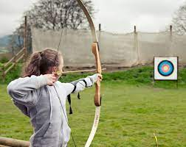
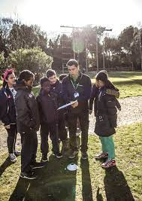
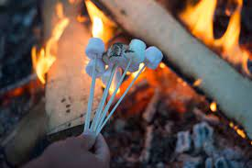

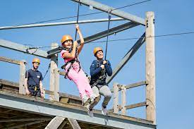
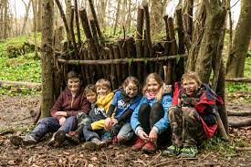
Bushcraft
Archery
Orienteering
Zip Wire
Notes:
Children will take part in many activities

Slide 9
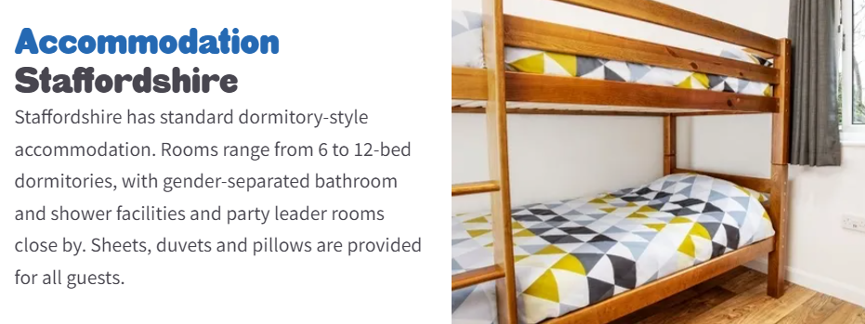
welcoming rooms in comfortable dormitory style accommodation
bathroom facilities and a daily housekeeping check
secure and comfortable with key code access and all bedding is provided
gender separated areas with separate showers and toilet facilities
teacher rooms are located close by to allow for plenty of supervision.

Slide 10
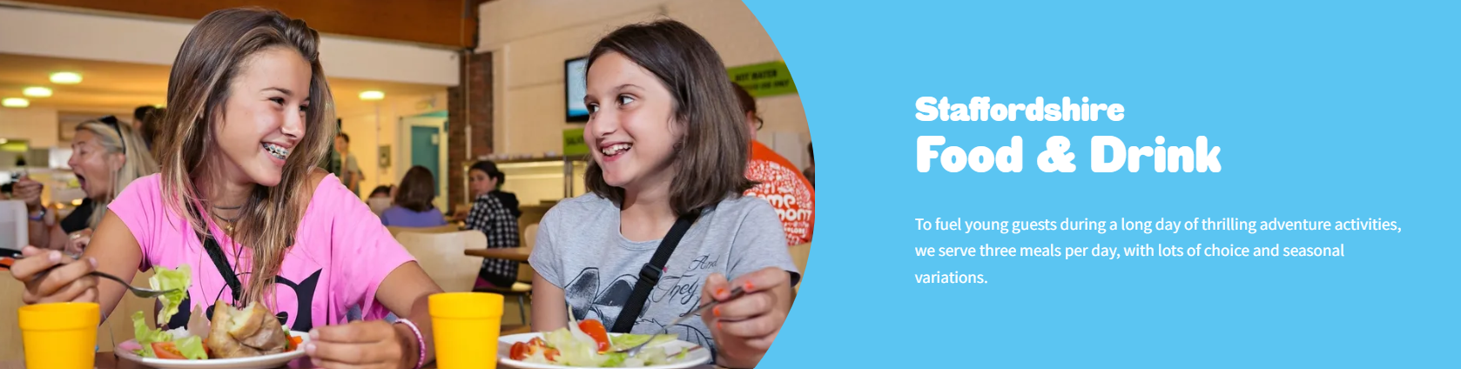

balanced variety of dishes
hot and cold meals available (including a salad bar and vegetarian options)
dietary requirements can be catered for

Slide 11
We know how daunting it can be letting your child go on a residential visit, so we do everything we can to make it a safe and enjoyable experience for all.
All staff are first aid trained
Regular checks on equipment
All staff DBS checked
Warm, supportive environment for students
Children are kept busy having fun ☺
School mobile
Our policies and procedures are designed to make sure we adhere to the highest safety standards at all times:
Continual safety and first aid training for all staff
Regular checks on equipment before and after every activity session
Qualified First-Aider on centre 24/7
All staff are fully DBS checked.
We create a warm, supportive environment for students so they quickly feel at home. All our activities are progressive, allowing students to join in at whatever level they’re comfortable with.
We have found the best way to help children cope with being away from home is to keep them busy, having fun from dawn ‘til dusk.
Kingswood cannot guarantee 100% safety for personal items brought onto centre and they will not be covered by insurance. It is therefore advisable to leave valuables – cameras, mobiles, iPods, MP3 players, computer games, jewellery - at home. A clearly named disposable camera is acceptable.
Notes:
Although the children won’t have their own mobile phones, we have a school phone for any contact that is needed
Updating the school blog with photos and information

Slide 12
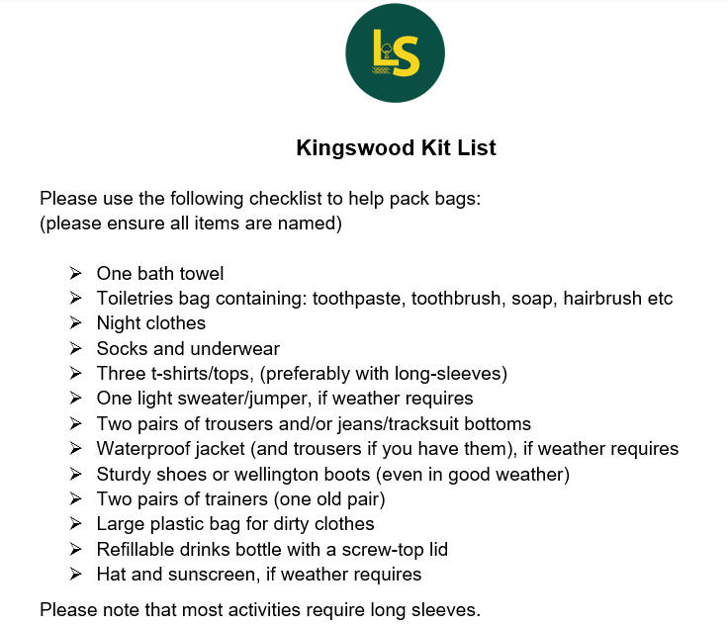
What to bring
Notes:
Kit list has been distributed – guidance of what to bring

Slide 13
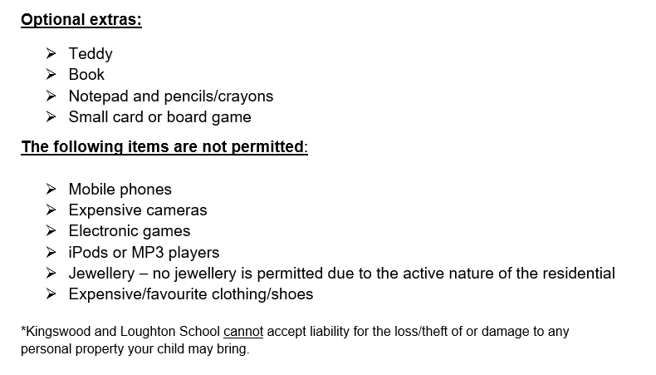
What to bring

Slide 14

We are happy to answer any questions you may have ☺
Notes:
Medication
Involvement – disabilities
Staff available
Bedtimes/waking up times
Sweets
Confirmation letter

